Slide 1
Randomized Algorithms CS648
Experimental results for Randomized Rumor Spreading Problem (PushNPull)

Slide 2
PushNPull Algorithm
It leverages both Push & Pull algorithms
Push Algo is fast in initial rounds
Pull Algo is fast in later rounds.
PushNPull follows Push algorithm until certain ratio (named switching_ratio in further slides) of population knows the rumor and then switches to Pull algorithm

Slide 3
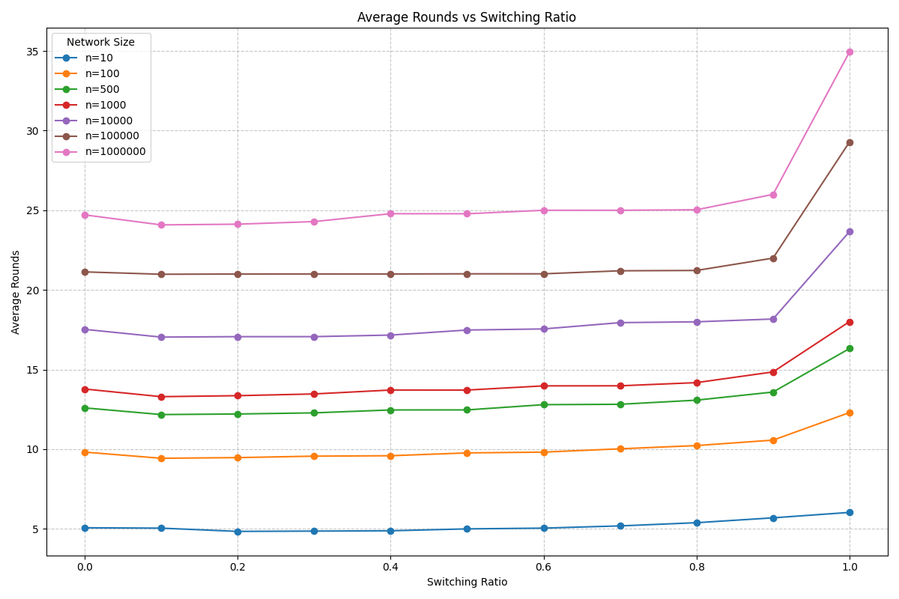
Average Rounds vs Switching ratio
Push Algorithm (switching ratio= 1.0) takes more round to complete otherwise it takes moreover same #rounds
*for each switching ratio 10^4 runs of algorithm
were done

Slide 4
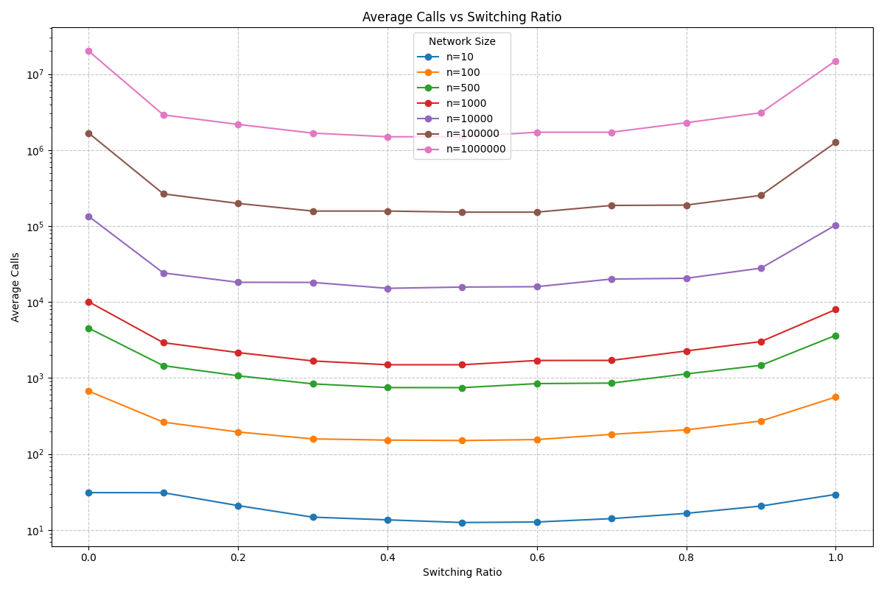
Average Calls vs Switching ratio
Switching Ratio=0.5
is minimizing avg. #calls
i.e.
Push Algo till n/2 people knows rumor and then Pull algo minimizes no. of calls required
*for each switching ratio 10^4 runs of algorithm were done

Slide 5
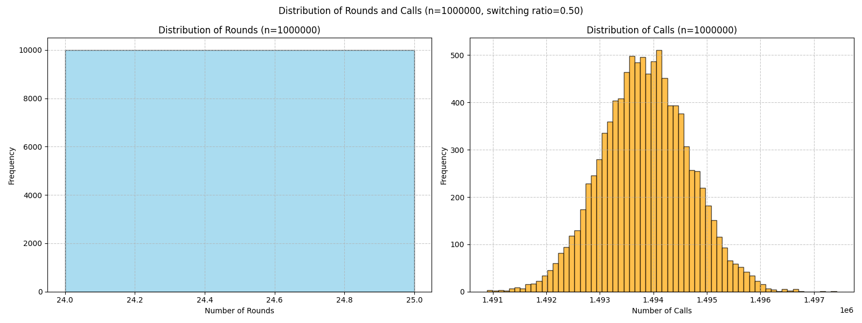

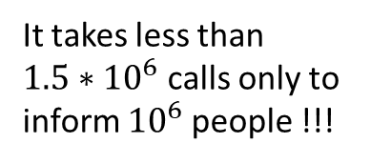
Distribution of Calls (n=${10}^{6}$, switching-ratio= 0.5)
It takes less than
$1.5∗{10}^{6}$calls only to inform ${10}^{6}$people !!!
*10^4 runs of algorithm
were done

Slide 6
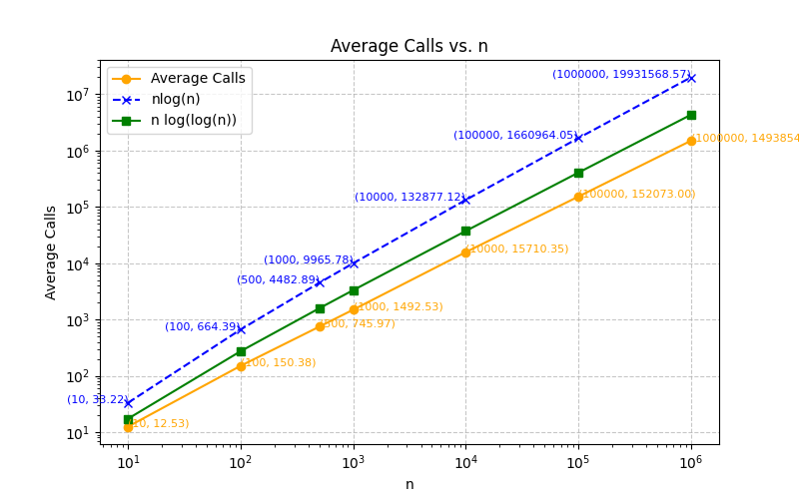
Average Calls vs n (switching-ratio= 0.5)

Slide 7
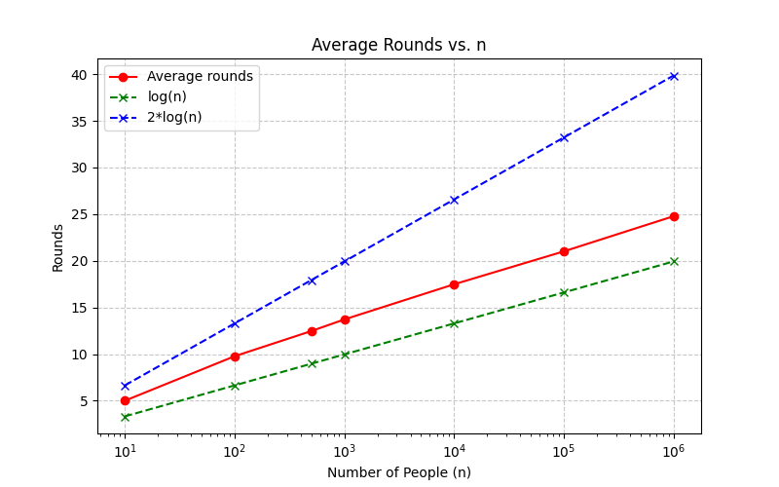
Average Rounds vs n (switching-ratio= 0.5)

Slide 8
Thank You!
Results prepared by Havi Bohra (210429), UG Y21 MTH

